Slide 1
Threads

Slide 2
Threads
Overview
Multithreading Models
Threading Issues

Slide 3
Threads
A thread (or lightweight process) is a basic unit of CPU utilization; it consists of:
program counter
register set
stack space
A thread shares with its peer threads its:
code section
data section
operating-system resources
collectively know as a task.
A traditional or heavyweight process is equal to a task with one thread

Slide 4
Threads (Cont.)
In a multiple threaded task, while one server thread is blocked and waiting, a second thread in the same task can run.
Cooperation of multiple threads in same job confers higher throughput and improved performance.
Applications that require sharing a common buffer (i.e., producer-consumer) benefit from thread utilization.

Slide 5
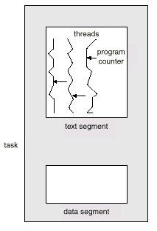
Multiple Threads within a Task

Slide 6
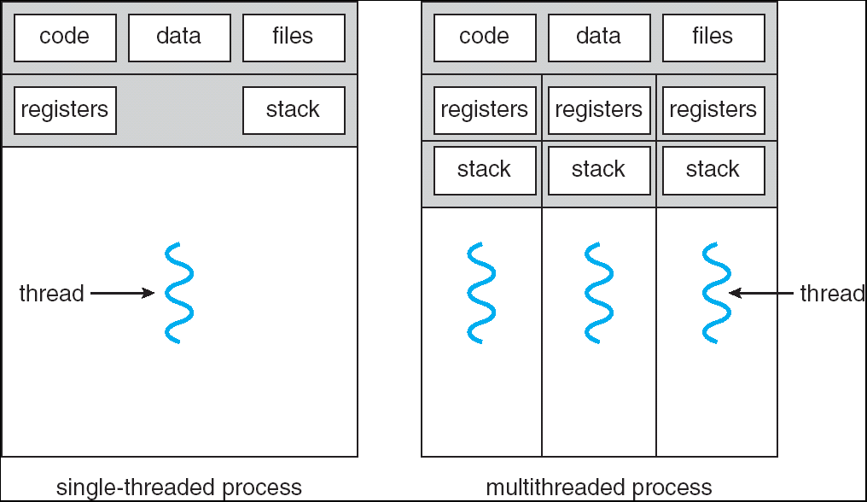
Single and Multithreaded Processes

Slide 7
Benefits
Responsiveness
Resource Sharing
Economy
Utilization of MP Architectures

